Slide 1
14. Participation & Voting
Breakout Sessions
POLS 1101
12:40pm-1:30pm Park Hall 145
& 1:50pm-2:40pm Leconte Hall 135
SIYUAN (Siri) ZHAO
Siri.Zhao@uga.edu
Notes:
Today we re going to talk about

Slide 2
Political Participation
Elections don’t guarantee democracy -> We need regular, competitive ones
Beyond elections, people need channels to influence politics.
  Conventional participation
  Unconventional participation (political “resistance” / contentious politics)
  Is there clear distinction between “conventional” and “unconventional” participation? What matters more in judging, intent (to change policy vs. to overthrow authority) matter or method (legal vs. illegal)?
    Teachers’ strike for higher salaries
    Online petition against a new surveillance law
    Civil rights march with government permit
    Farmers block highways to protest low crop prices
    A student organization hosts a campus debate on voting reform
    Environmental NGO sues the government for failing to meet emission targets
    Voters boycott an election to protest corruption
Notes:
有没有新成员进入？Civil rights march
答案会随政治语境而变化：学生会(美国，中国)

Slide 3
Unconventional Participation
Key feature: (the intent) against the established order/norms/institutions
Some other characteristics
  Collective action involving “new” agents (e.g. the Selma Marches)
  -> Direct action: unconventional participation that involves assembling crowds to confront businesses and local governments to demand a hearing
  Unconventional / ”illegal” methods (varied, contextualized definitions)
  Depending on some political opportunity structures
  Always having emotional and symbolic slogans / claims
  -> People using unconventional behavior often have a strong group consciousness
  Can lead to social change, or damage (depending on state capacity and government responsiveness)
Should governments tolerate disruptive but nonviolent actions (e.g. sit-ins)?
When, if ever, is violent political participation justified?
  Freedom, Order, and Equality

Slide 4
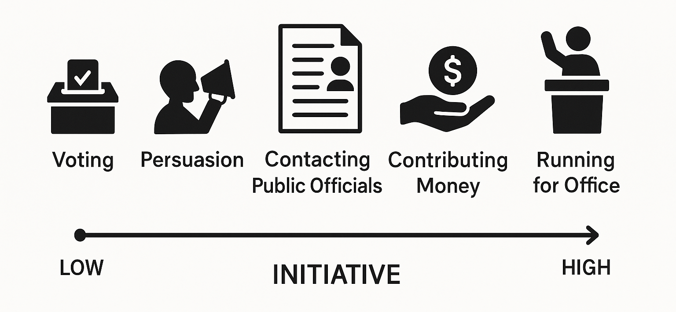
Conventional Participation
Share some of your experiences of “conventional participation”!
The objective of democratic institutions is to make political participation conventional.
  For particular benefits (supported by rationalism and pluralism): ask for services from the local government; contributing money to a candidate’s campaign
  For broad policy objectives (not directly related to individuals)
    Often related to elections, but not restricted in elections!
    Legislative process: congressional hearing
    Judicial process: class action suit (a legal action brought by a person or group on behalf of a number of people in similar circumstances)
Public
Service
Motivation
Resources
Notes:
Share some of your experiences of “conventional participation”!

Slide 5
Participation through Voting
Key concepts: suffrage / franchise (right to vote), voter turnout (actual voting rate)
Expansion of suffrage – Equality (Elections serve most the ideal of equality.)
  Blacks: Smith v. Allwright (1944) -> the Voting Rights Act of 1965 -> Harper v. Virginia State Board of Elections (1966)
  Women: Wyoming (1869) -> Equal Rights Party -> the 19th Amendment (1919)
  The 26th Amendment (1920): lowering the voting age to eighteen
Voting on policies
  Dating back to progressivism
  How? Initiative; referendum
Voting for (in the state and local level, even ALL kinds of) candidates
  Ideal assumptions: 1) Voters know what politicians are doing in office and participate actively;
  2) They can choose the “best” candidate, reelect the qualified incumbent and kick out bad ones;
  3) Officeholders are motivated to respond to public opinion by the threat of electoral defeat.

Slide 6
Did shark attacks eat into Woodrow Wilson’s votes in 1916?
Achen and Bartels: President Woodrow Wilson lost votes in affected counties because citizens irrationally punished him for “natural” events beyond his control — a phenomenon they called the “shark attack effect.”
  This challenges the rational assumption of retrospective voting.
  Elections may reflect emotional attributions rather than actual performance.
Fowler and Hall: The supposed effect was statistically insignificant and far smaller than claimed. The original study overstated voter irrationality.
  Even if individual voters behave irrationally, aggregate voting patterns can remain rational.
  -> Do you agree with this idea?
Key question: Are voters rational, and do elections truly function as effective mechanisms of accountability?
  We have known that unconventional participation can be depicted as emotional, while the most conventional form – voting, can also involve personal feelings.
  In cases like this, does voting still represent meaningful participation, or merely symbolic expression?
Notes:
3 minutes to read this material

Slide 7
Political Participation and Democracy
Majoritarianism
  Favoring conventional, institutionalized behavior, primarily voting in elections
    How elections contribute to democracy? (p.198)
    Allowing citizens to choose among candidates or issues;
    Socializing political activity, turning citizen claims into routine public function;
    Institutionalizing access to political power;
    Bolstering the state’s power and authority.
  Stressing equality in political participation, collective decisions formalized through elections; having little place for motivated, resourceful individuals
  Narrowing the scope of participation by defining which are orderly / acceptable
Pluralism
  Decentralization & complexity allows many points of access (freedom) and accommodates various forms of conventional participation in addition to voting.
  Offering citizens the opportunity to be treated as individuals when dealing with the government, to influence policymaking, and to fulfill their social potential

Slide 8
Explaining Political Participation
The standard socio-economic explanation
  More education, higher income, white-collar occupations are related to more awareness, capability, and resources to higher (conventional) participation.
  For unconventional participation, those who protest against US government policies tend to be more educated.
    Is it a universal conclusion across the world?
    What factors can lead to changes of such a pattern?
Notes:
Raise your hands -> share ideas

Slide 9
Explaining Political Participation (cont`d)
Low voter turnout in America
  Which matters more in deciding the “value” of voting, “frequency” or “substance” ?
    As many elections as possible
    Elections that cover as many issues as possible
  Explanations for the low voter turnout
  Low willingness of young people to vote (accounting for low turnout right after the ratification of the 26th Amendment) – pay attention to definitions!
  Attitude changes toward the government (low responsiveness)
  High learning costs, compliance costs, psychological costs in registration / voting
  Low individual-level “punishment” for not voting (the Australia example!)
    Why do some of you support compulsory voting (if any)? – 33% according to the “opinion poll” in our lecture, a proportion that cannot be overlooked
  Lack of political parties that mobilize the vote of particular social groups (its effect also depends on type of citizens, nature of the election, and even random factors – e.g. weather!)

Slide 10
Next week…
Read materials on Campaigns & Elections before class, and that will be helpful to participate in peer discussions.
Feel free to email me if you have any questions!
ENJOY YOUR WEEKEND!

